Slide 1

Geometry
Unit 1, Lesson 9 Copying an Angle Volume 1, pg. 58

Slide 2


Benchmarks
MA.912.GR.1.1
Prove relationships and theorems about lines and angles. Solve mathematical and real-world problems involving postulates, relationships, and theorems of lines and angles.
MA.912.GR.5.1
Construct a copy of a segment or an angle.
volume 1, pg. 58

Slide 3
Integrated Mathematical Thinking and Reasoning Standard
MA.K12.MTR.1.1 Actively participate in effortful learning both individually and collectively.
volume 1, pg. 58

Slide 4

Learning Targets
I can construct a copy of an angle.
I can use the angle addition postulate.
volume 1, pg. 58

Slide 5

Warm-Up
volume 1, pg. 59

Slide 6
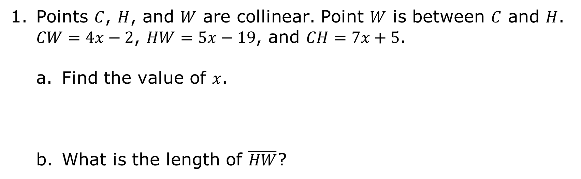
1.9.1 Warm-Up: Bell Work
Points $C$, $H$, and $W$ are collinear. Point $W$ is between $C$ and $H$. $CW=4x−2$, $HW=5x−19$, and $CH=7x+5$.
Find the value of $x$.
What is the length of $\overline{HW}$?
volume 1, pg. 59

Slide 7

Activity
volume 1, pg. 59

Slide 8


1.9.2 Activity: Copying an Angle
$∠FGH$ is shown.
Discuss with your partner how to copy $∠FGH$ using only a compass.
volume 1, pg. 59

Slide 9
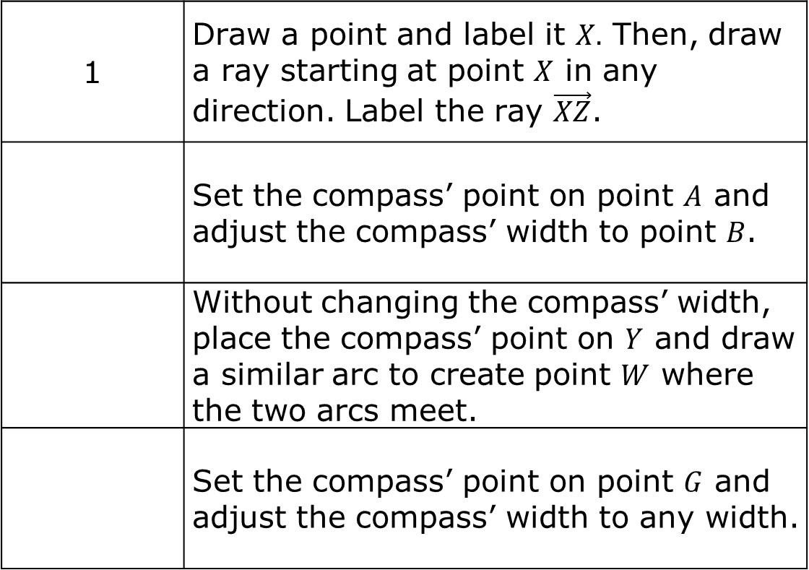
Work with your partner to order the nine steps for copying $∠FGH$. The first and last step are in the correct position.
1 | Draw a point and label it $X.$ Then, draw a ray starting at point $X$ in any direction. Label the ray $\vec{XZ}$.
 | Set the compass’ point on point $A$ and adjust the compass’ width to point $B$.
 | Without changing the compass’ width, place the compass’ point on $Y$ and draw a similar arc to create point $W$ where the two arcs meet.
 | Set the compass’ point on point $G$ and adjust the compass’ width to any width.
volume 1, pg. 60

Slide 10
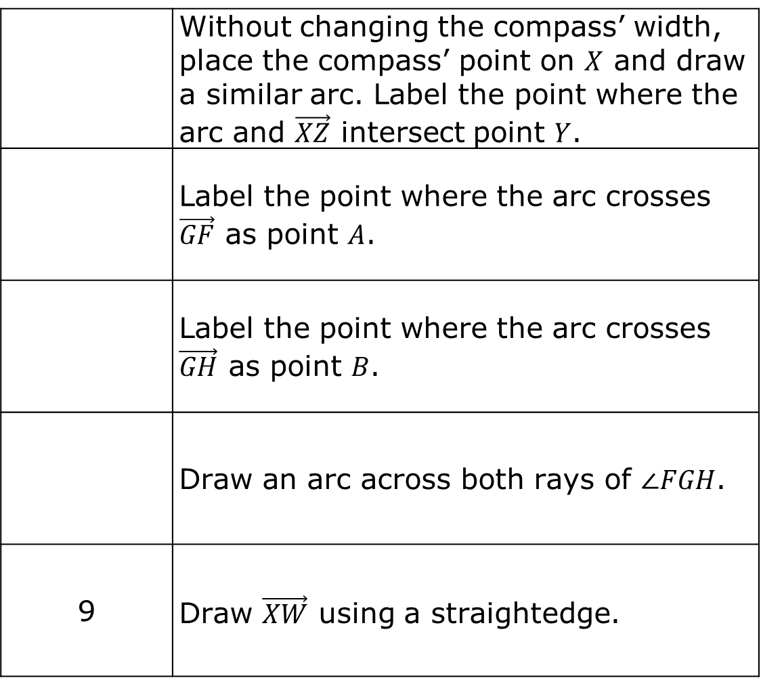
 | Without changing the compass’ width, place the compass’ point on $X$ and draw a similar arc. Label the point where the arc and $\vec{XZ}$ intersect point $Y$.
 | Label the point where the arc crosses $\vec{GF}$ as point $A$.
 | Label the point where the arc crosses $\vec{GH}$ as point $B$.
 | Draw an arc across both rays of $∠FGH$.
9 | Draw $\vec{XW}$ using a straightedge.
volume 1, pg. 60

Slide 11
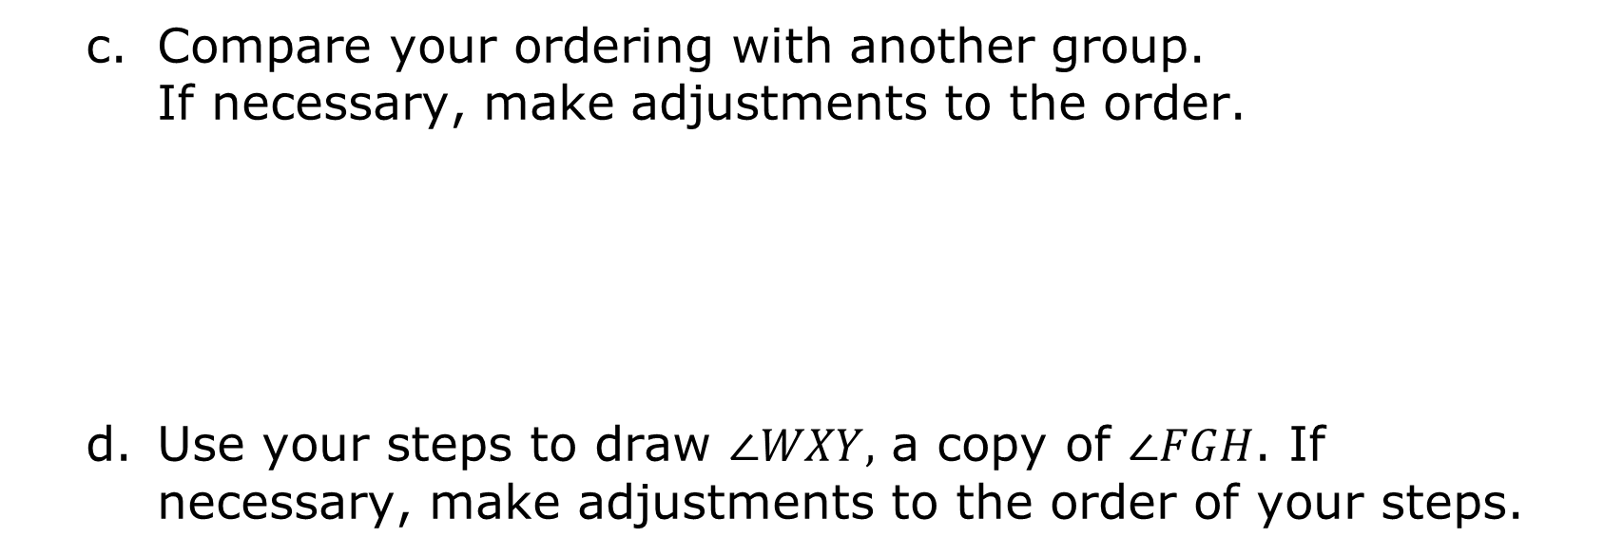
Compare your ordering with another group. If necessary, make adjustments to the order.
Use your steps to draw $∠WXY,$ a copy of $∠FGH$. If necessary, make adjustments to the order of your steps.
volume 1, pg. 60

Slide 12

Guided Instruction
volume 1, pg. 61

Slide 13

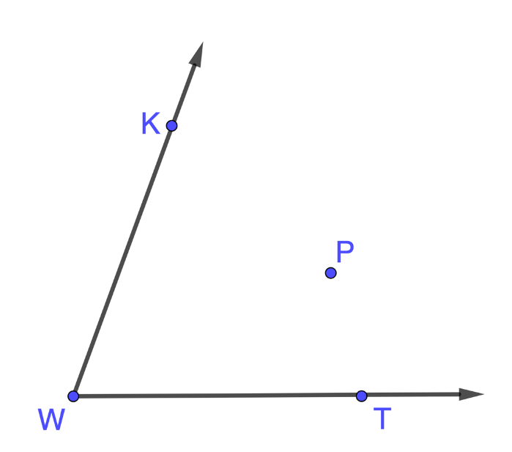
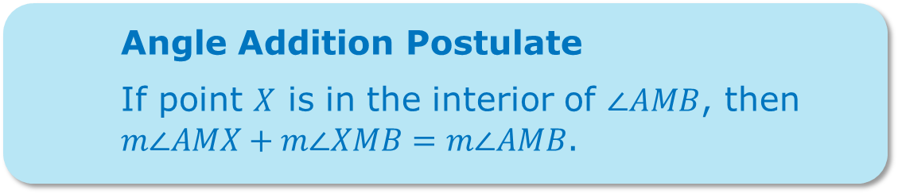
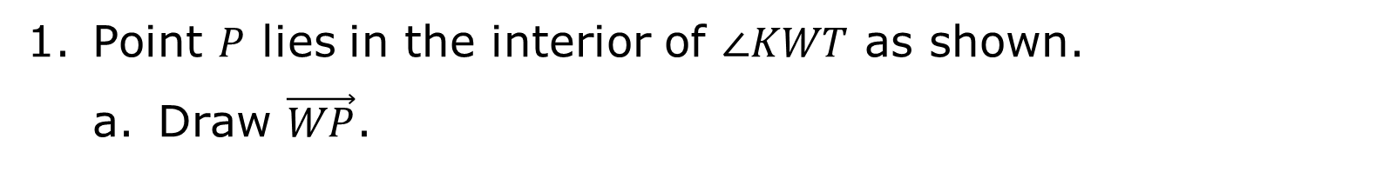
1.9.3 Guided Instruction: Angle Addition Postulate
Angle Addition Postulate
If point $X$ is in the interior of $∠AMB$, then $m∠AMX+m∠XMB=m∠AMB$.
Point $P$ lies in the interior of $∠KWT$ as shown.
Draw $\vec{WP}$.
volume 1, pg. 61

Slide 14
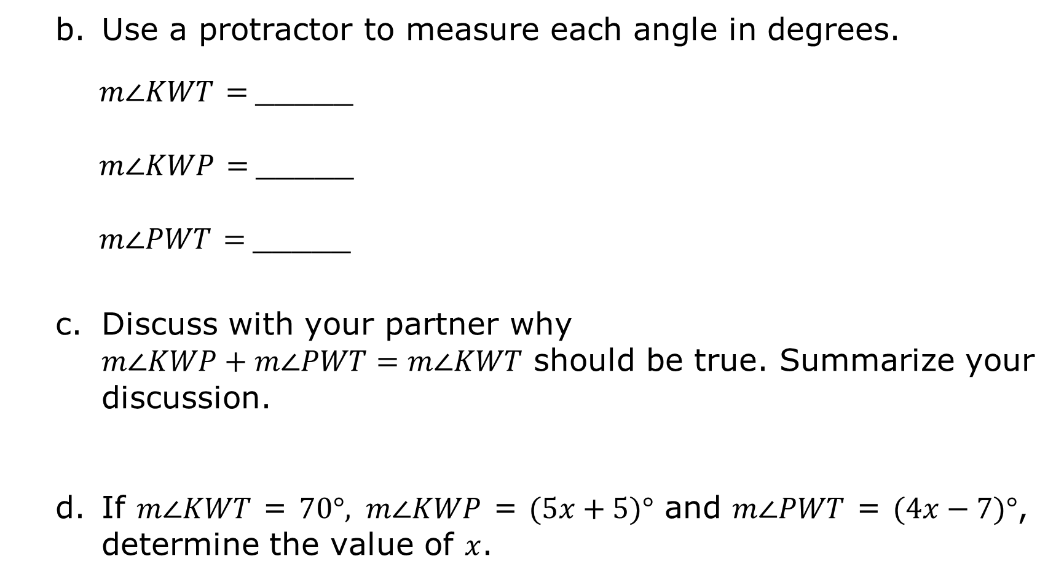
Use a protractor to measure each angle in degrees.
$m∠KWT$ $=$_____
$m∠KWP$ $=$_____
$m∠PWT$ $=$_____
Discuss with your partner why
$m∠KWP+m∠PWT=m∠KWT$ should be true. Summarize your discussion.
If $m∠KWT$ = $70°, m∠KWP$ = $(5x+5)°$ and $m∠PWT$ = $(4x−7)°$, determine the value of $x$.
volume 1, pg. 61

Slide 15

Try It
volume 1, pg. 62

Slide 16


1.9.4 Try It: Copying an Angle
$∠KLM$ is shown.
Draw $∠RST,$ a copy of $∠KLM$.
volume 1, pg. 62

Slide 17
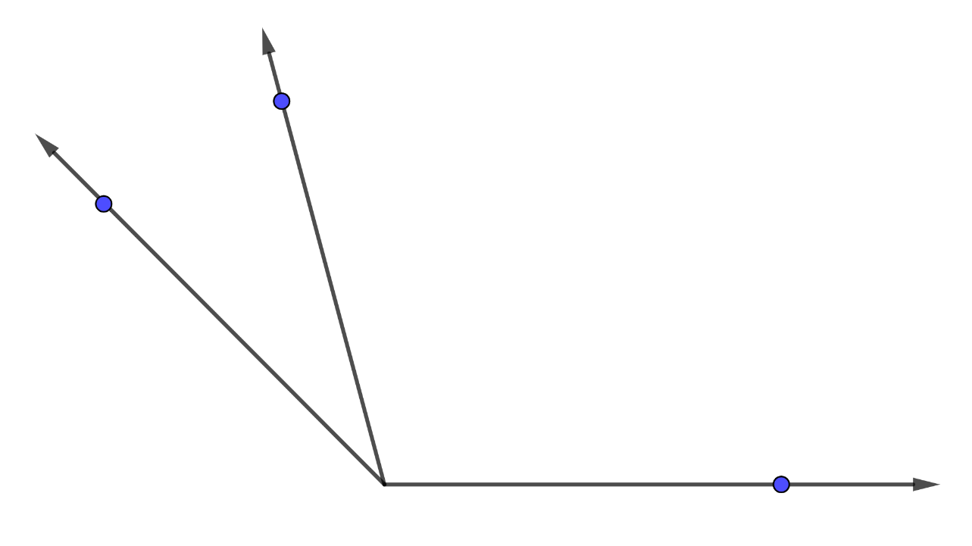





Three angles are shown, $∠WEL$, $∠LER$, and $∠WER$.
If $m∠LER=(14.35x−9.8)°$, $m∠WEL=(2.5x+10)°$, and $m∠WER=135°$, what is $m∠WEL$?
$$L$$
$$W$$
$$E$$
$$R$$
volume 1, pg. 62

Slide 18

Wrap-Up
volume 1, pg. 63

Slide 19
1.9.5 Wrap-Up: Cool Down
Write an explanation to a classmate who might have missed today’s lesson, in your own words, about copying an angle.
volume 1, pg. 63

